Slide 1
Thinking Slow Thinking Fast
Final Project Presentation
CIS6930: Information Visualization
By -
Ashish Aggarwal, Abhishek Kulkarni
Nishtha Shrivastav, Swarada Sathe

Slide 2
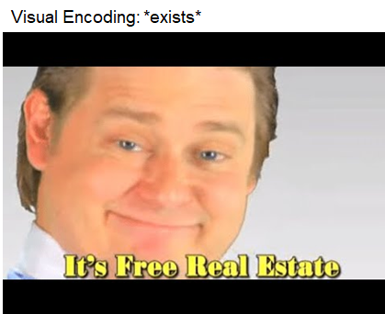
Motivation
Motion:
Preliminary research showed animated visualizations cause distraction
Depicting change in temporal data over time- Is motion the answer?
Notes:
Does Animation Attract Online Users’ Attention? The Effects of Flash on Information Search Performance and Perceptions
Weiyin Hong, James Y. L. Thong, Kar Yan Tam

Slide 3
Change in crime rates over a decade in United States
https://www.reddit.com/r/atheism/comments/34b35a/most_crime_in_the_conservative_states_otherwise/

Slide 4
Research Question
How does motion affect a user’s perception of a visualization, when it is paired with the traditional encodings?
Does the speed of the motion influence the perceptual ability of the user?

Slide 5
Related Work
Motion in visualizations causes distractions - L. Bartram, C. Ware, and T. Calve
Role of types motion- flicker, direction and velocity, in visualizations
- Daniel E. Huber Christopher G
User study comparing static with moving visualizations - Chien-Hsin Hsueh, Jia-Kai Chou, Kwan-Liu Ma
Notes:
Distractions: Does Animation Attract Online Users’ Attention? The Effects of Flash on Information Search Performance and Perceptions
Moticons: detection, distraction and task. International Journal of Human-Computer Studies
A study of using motion for comparative visualization
Visualizing Data with motion
A Study of using Motion for Comparative Visualization
Chien-Hsin Hsueh∗ Jia-Kai Chou† Kwan-Liu Ma‡

Slide 6

Study Design
Sean Bean aka Boromir aka Ned Stark

Slide 7
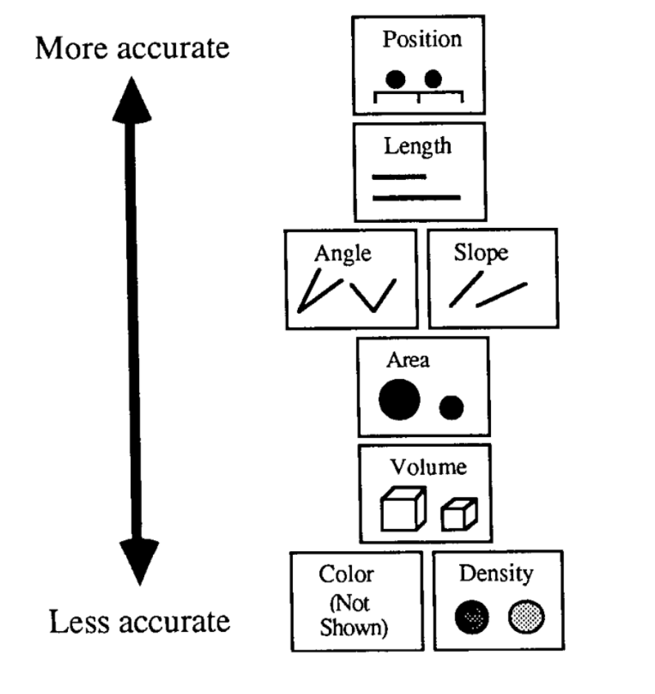
Study Design
5 data encodings combined with motion for analysis
Position
Length
Angle
Area
Color
26 participants
Cleveland and McGill Rankings

Slide 8
Study Design
Survey of 21 questions
Four categories in encodings:
Static (as control)
Slow motion
Medium motion
Fast motion
 | Static | Slow | Medium | Fast
Actual Values | x | y | y | z

Slide 9
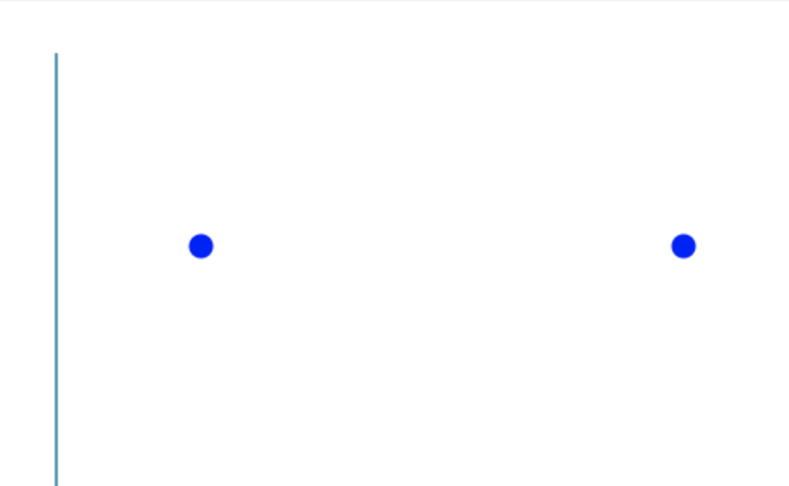
Survey Design
Sample questions from the survey: Position
Question:
If circle 1 is at distance of 1 unit from the line,
what is the distance of circle 2 from the line ?
Circle 1 is the figure closest to the line and
circle 2 is the one farthest.

Slide 10
Survey Design
Don’t mind me, I’m just a blue circle using motion
Dynamic visualizations with varying speeds: Position
Slow Medium Fast

Slide 11
Survey Design
Variations in direction of motion for: Length

Slide 12

Analysis Task
Sample questions from the survey: Area
Question:
If the initial size of the circle is 100,
what would you say is the size of
the smallest circle in the transition?

Slide 13
Encoding: Area
Dynamic visualizations with varying speeds: Area
Slow Medium Fast

Slide 14
Evaluation: Area
 | Static | Slow | Medium | Fast
Actual Values | 25 | 20 | 20 | 40
Median | 10 | 10 | 16 | 30
Median Error | -15 | -10 | -4 | -10

Slide 15
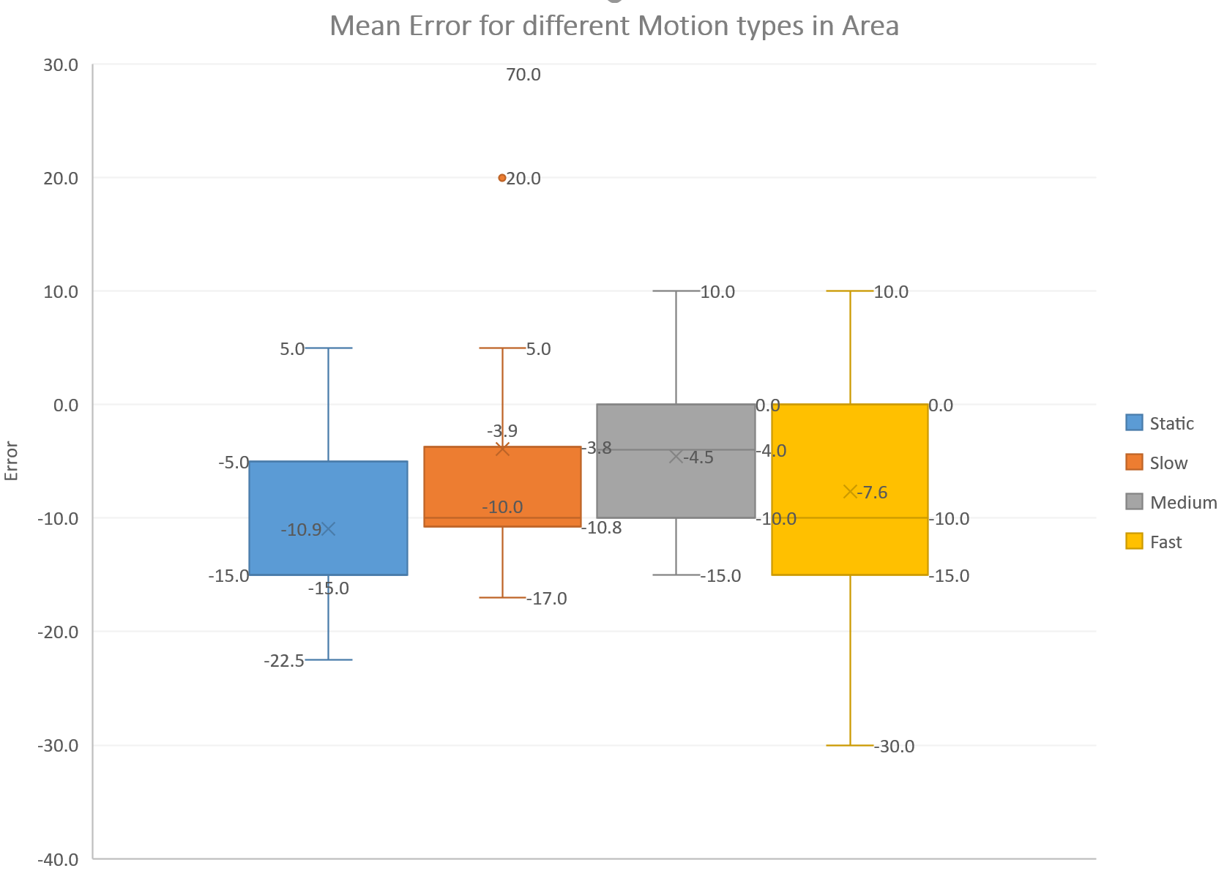
Evaluation: Area

Slide 16

Comparing for Area with Increasing Speed
An independent samples t-test was conducted for Static and Slow speed
t(21) = -1.65121
The p-value is < .106
The results are not statistically significant.
 | Static | Slow
Actual Values | 25 | 20
Median | 10 | 10
Median Error | -15 | -10

Slide 17

Comparing for Area with Increasing Speed
An independent samples t-test was conducted for Static and Medium speed
t(21) = -3.02
The p-value is < .0042
The results are statistically significant.
 | Static | Medium
Actual Values | 25 | 20
Median | 10 | 16
Median Error | -15 | -4

Slide 18
Comparing for Area with Increasing Speed
An independent samples t-test was conducted for Static and Fast speed
t(21) = -1.1342
The p-value is < .2631
The results are not statistically significant.
 | Static | Fast
Actual Values | 25 | 40
Median | 10 | 30
Median Error | -15 | -10

Slide 19
Takeaways?
There is a significant difference in comparing Static with Medium pace motion
There is an optimum speed at which the perception significantly differs
 | Static | Slow | Medium | Fast
Actual Values | 25 | 20 | 20 | 40
Median | 10 | 10 | 16 | 30
Median Error | -15 | -10 | -4 | -10

Slide 20
Encoding: Angle
Variations in direction of motion for: Angle
Slow Medium Fast

Slide 21
Evaluation: Angle
 | Static | Slow | Medium | Fast
Actual Values | 30 | 45 | 60 | 60
Median | 40 | 47 | 60 | 60
Median Error | 10 | 2 | 0 | 0

Slide 22
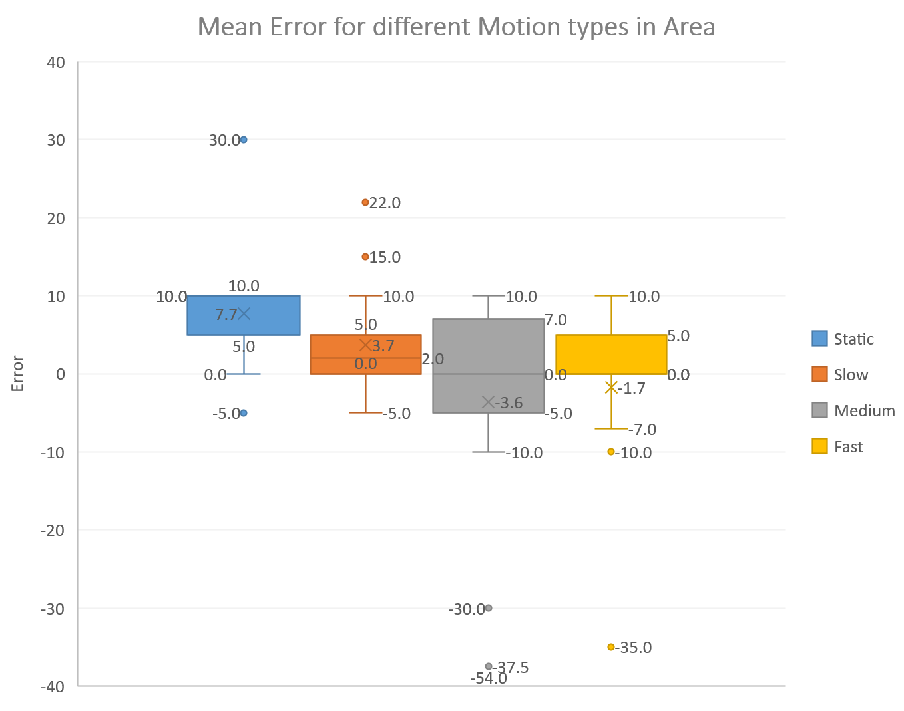
Evaluation: Angle

Slide 23
Comparing Angle values with Motion
An independent samples t-test was conducted for Static and Slow speed
The t(22) = 2.07
The p-value is .044284
The result is statistically significant.
 | Static | Slow
Actual Values | 30 | 45
Median | 40 | 47
Median Error | 10 | 2

Slide 24
Comparing Angle values with Motion
An independent samples t-test was conducted for Static and Medium speed
The t(22) = 3.0845.
The p-value is .003517
The result is statistically significant.
 | Static | Medium
Actual Values | 30 | 60
Median | 40 | 60
Median Error | 10 | 0

Slide 25
Comparing Angle values with Motion
An independent samples t-test was conducted for Static and Fast speed
The t(22) = 3.377
The p-value is .0055555
The result is statistically significant.
 | Static | Fast
Actual Values | 30 | 60
Median | 40 | 60
Median Error | 10 | 0

Slide 26

Takeaways?
Motion has a significant impact on user’s perception of values in Angles
The impact is positive

Slide 27
Takeaways?
Motion has a significant impact on user’s perception of values in Angles
The impact is positive
After a certain speed, no significant change is observed
 | Static | Slow | Medium | Fast
Actual Values | 30 | 45 | 60 | 60
Median | 40 | 47 | 60 | 60
Median Error | 10 | 2 | 0 | 0

Slide 28


Results
 | Significant Difference? | Accuracy?
Position
Length
Angle
Area |  | Mixed
Color |  | Mixed

Slide 29
Contributions
Effectiveness of motion to indicate change varies with different visual encodings
For few use cases we discovered that there is an optimum speed for depicting change in encoding values
Further exploration possibilities for encodings - angle and position

Slide 30
Limitations
Not a controlled survey
Evaluation done on limited amount of data
Effectiveness of adding motion when multiple encodings are used in a visualization

Slide 31
References
[1] W. S. Cleveland and R. McGill. Graphical perception: Theory, experimentation, and application to the development of graphical methods.
[2] L. Bartram, C. Ware, and T. Calvert. Moticons: detection, distraction and task. International Journal of Human-Computer Studies
[3] Daniel E. Huber Christopher G., IEEE (2005) – Healey Visualizing Data with Motion
[4] Bartram, L., & Nakatani, A. (2010, November). What makes motion meaningful? Affective properties of abstract motion.

Slide 32
“We see in order to move; we move in order to see”
-William Gibson
-Michael Scott
Questions?

